Slide 1
WORLD PREMIERE

Slide 2
Soma Personality Test Software
DIP Group 6
Ang Jing Jing, Guerta Uno Gabriel Yap, Heng Zi Hui, Jocelyn Valencia Yoswara, Audrey Lee Chi Yan, Luo Chongwei, Muhammad Arif Bin Abdul Malek, Vanessa Christy Chandra, Wu Hongrui

Slide 3
01
Background
& Objectives
Problem statement & Our proposed solution

Slide 4
Background & Motivation
Personality Tests’ popularity
Mobile market unexplored

Slide 5
$3,000,000,000
Spent by companies to evaluate potential hires

Slide 6
How can we innovate beyond the test?

Slide 7
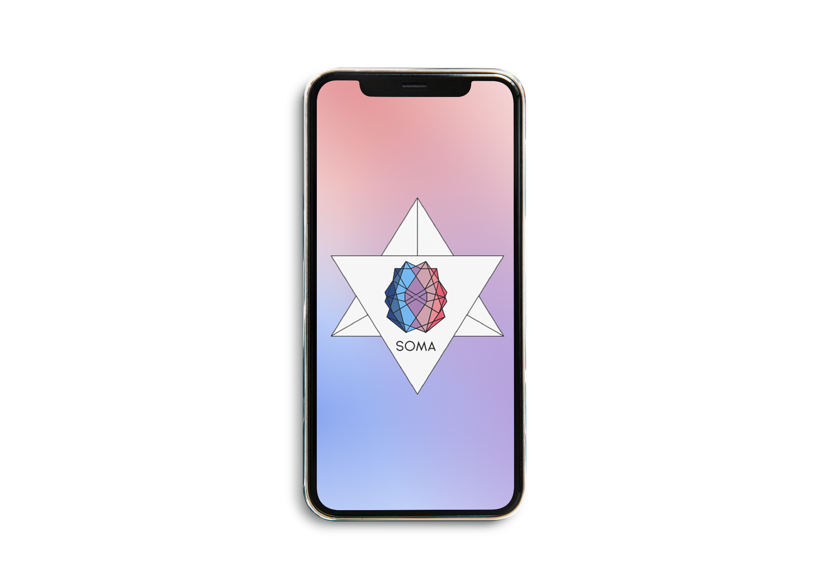

Slide 8
Team Lead – UI / UX Design , SOMA

Slide 9
02
Design
& Prototype
Our solution & What it offers

Slide 10
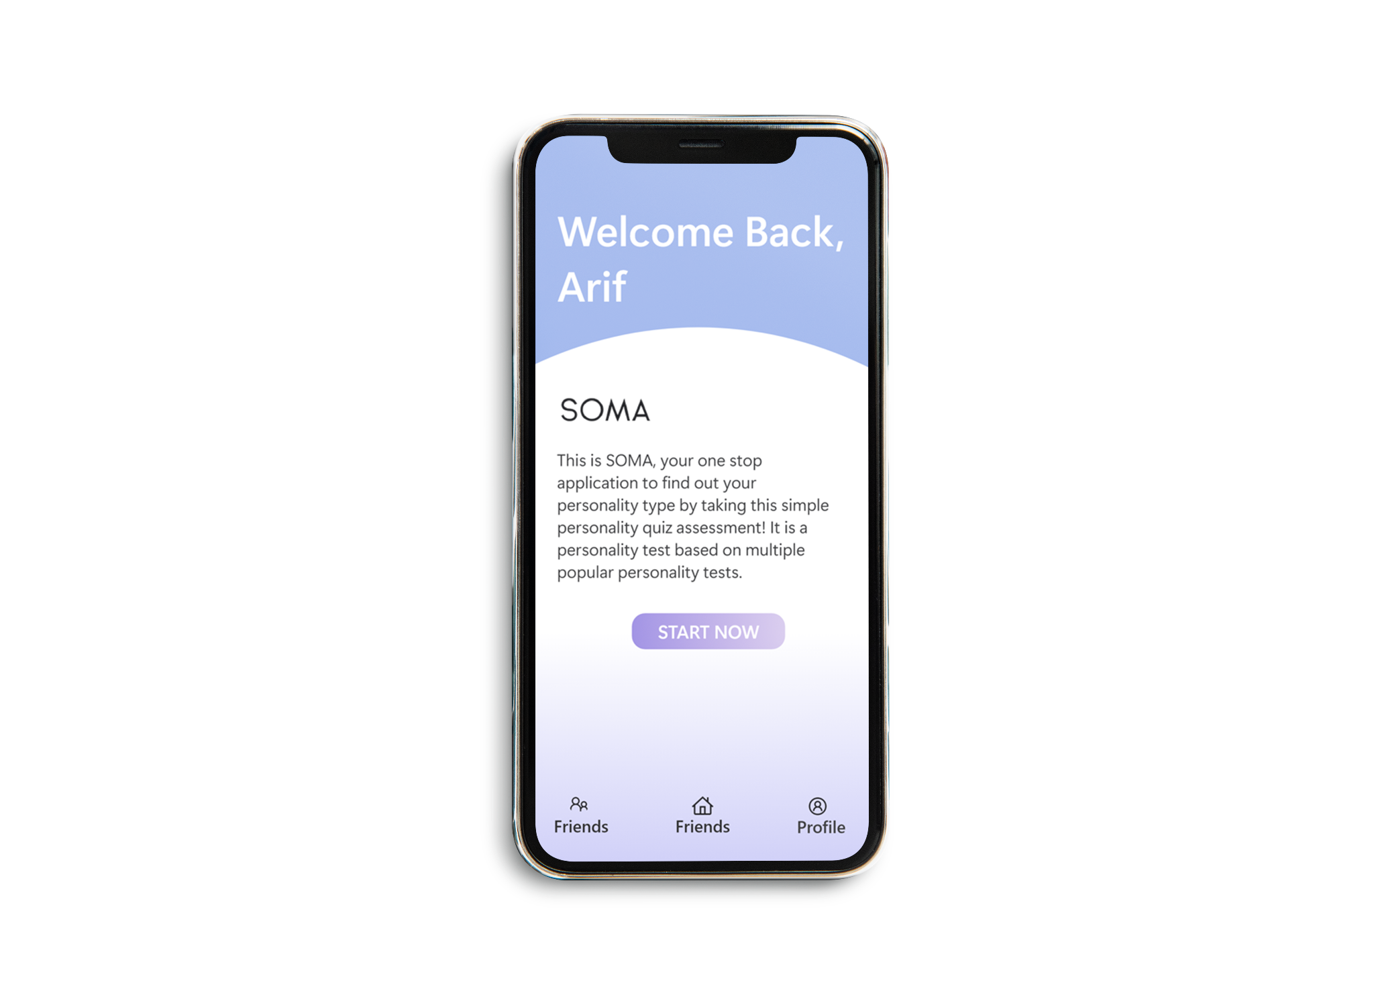
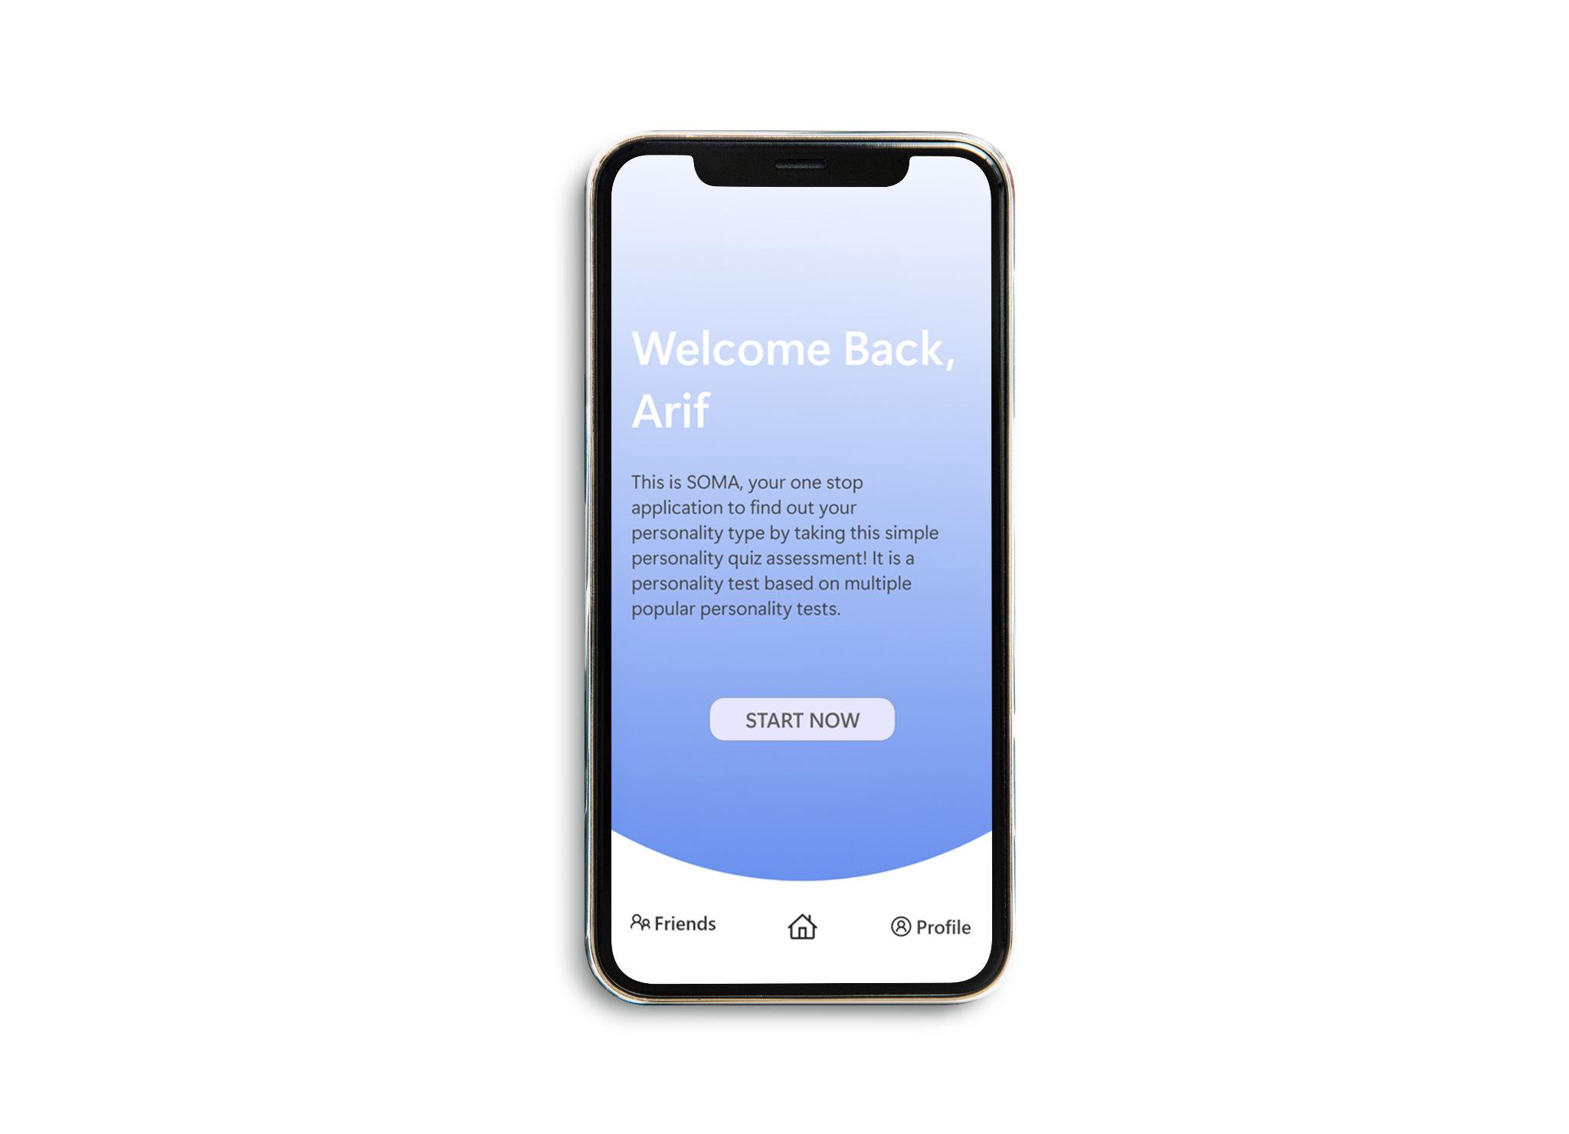
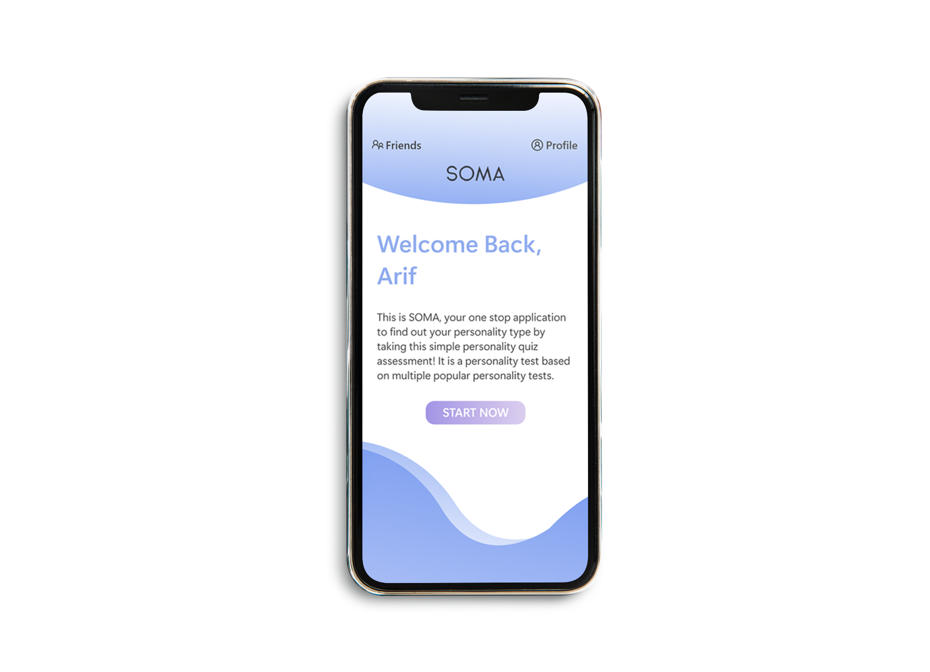
UI Design Ideation

Slide 11
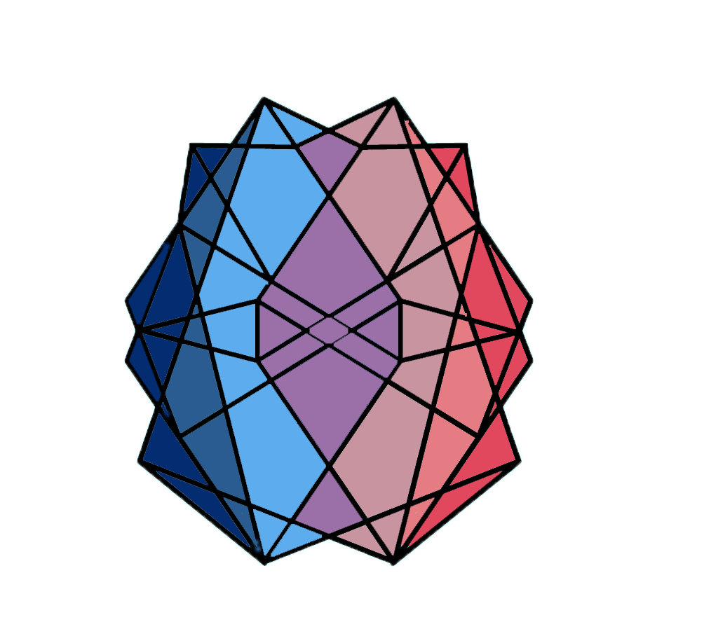
Colour Scheme
Hex: #9870CD
Hex: #9870CD
Hex: #9870CD

Slide 12
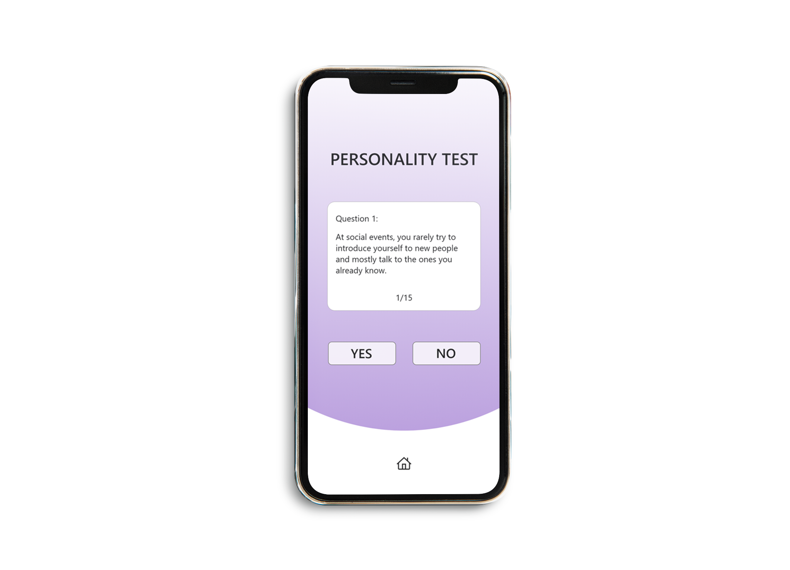
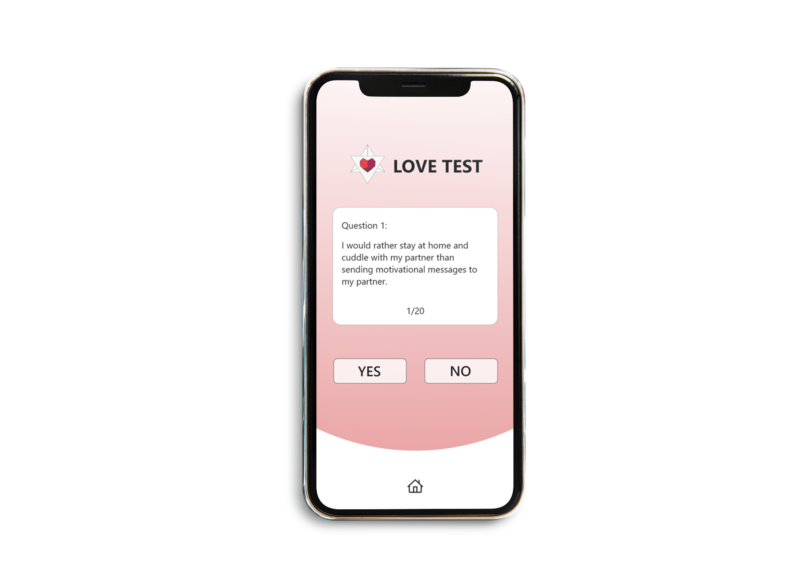
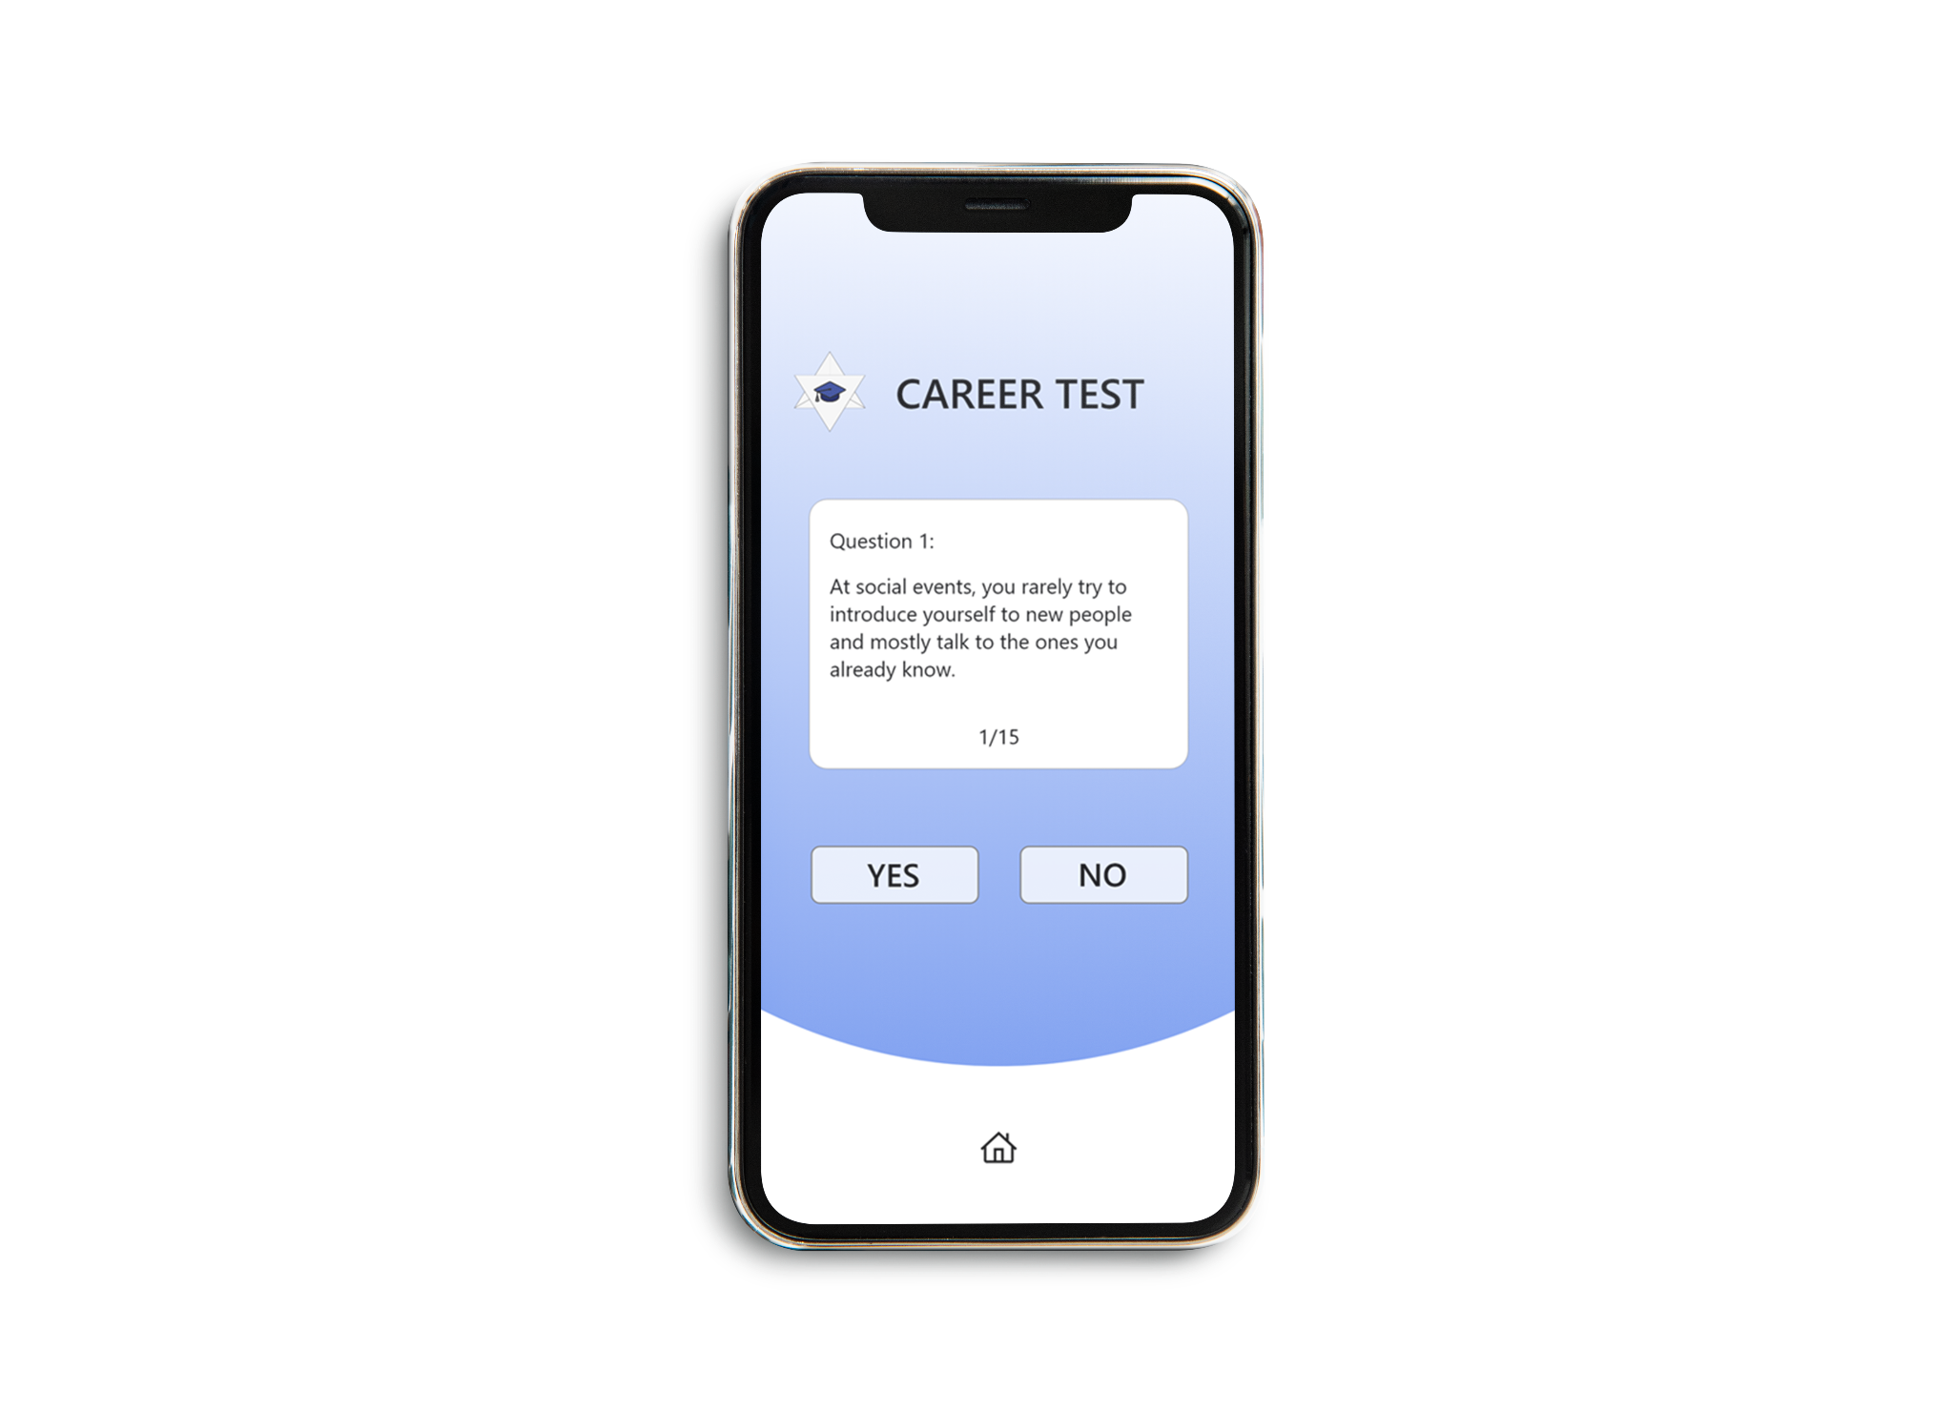

Slide 13
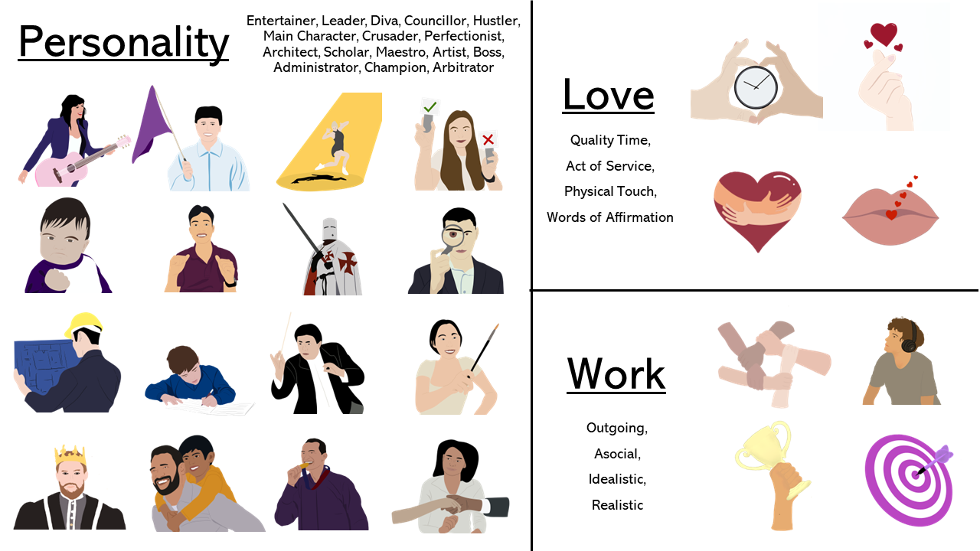
Avatars

Slide 14
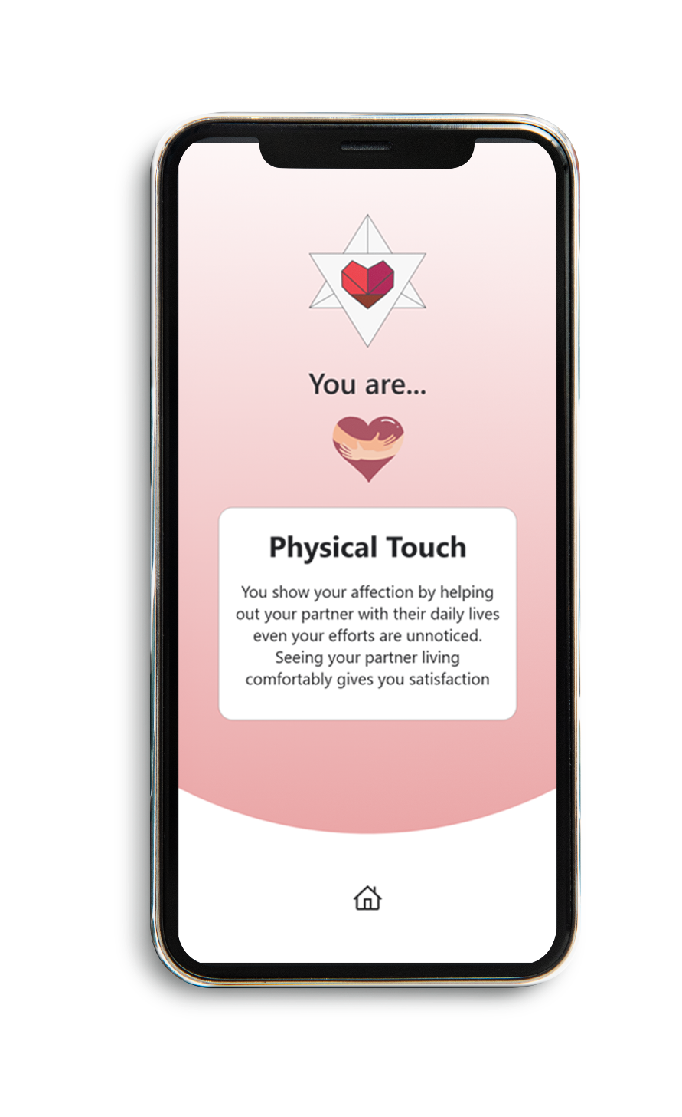
Results Page

Slide 15
Senior Full-stack Developer, SOMA

Slide 16
Test & Functions

Slide 17
Quiz Process
Measurements
Anytime, Everywhere
Objectivity
Accessibility
Validity
Reliability
3 Main Categories
Result

Slide 18
Functions
Security
Encryption
Transparency
Connect
Control
Discover

Slide 19
LIVE DEMO

Slide 20
03
Lessons
& Conclusion
Tools, analysis & what we learnt

Slide 21
Lessons Learnt
Problem-solving
Efficiency
Time management
Teamwork & Communication
Unfamiliar errors and countless hours of troubleshooting
Knowing each other’s strengths and using it effectively
Meet milestones/deadlines
Regular updates and knowing each other’s roles

Slide 22
Q & A

